Slide 1

Our Veterans the Angels Among Us
Scholarship Program
2023-2024

Slide 2

Scholarship Program Goals
Participation:
in each of the programs by promoting
Recognition:
all entries and winners, also include your judges
Program Awareness:
promote the programs at schools, community, and clubs
Scholarship Fund Building:
hold activities or fundraisers to build scholarship funds at the
local, district, department and national levels

Slide 3

Voice of Democracy 9th – 12 grade
Theme for 2023-2024:
“What Are the Greatest Attributes
of Our Democracy?”

Slide 4

New top National VOD prize is $35, 000

Slide 5

VOD Rules and Regulations
This contest is open to all students, including home schooled students, in grades 9-12. Students must be a resident of the state where entered.
Students write and then record their original 3-5-minute essay on the theme announced on an audio flash drive. Please refer to student brochure that can be found at www.vfwauxiliary.org/scholarships for complete details on requirements and application for contest.
This is a VFW program and we as an auxiliary are here to support the post and promote the program
Must read essay word for word, and not identify themselves
All entries must include completed application, printed copy of the essay, Student Bio, wallet size photo and school release

Slide 6

Patriot Pen 6th -8th grade
Theme for 2023-2024:
“How Are You Inspired by America?”

Slide 7

PP Rules and Regulations
This contest is open to all students, including home schooled students, in grades 6-8th grade. Students must be a resident of the state where entered.
Students write their original essay on the theme announced. Please refer to student brochure that can be found at www.vfwauxiliary.org/scholarships for complete details on requirements and application for contest.
This is a VFW program and we as an auxiliary are here to support the post and promote the program.
All entries must include completed application, a printed copy of essay, Student Bio, wallet size photo and school release

Slide 8
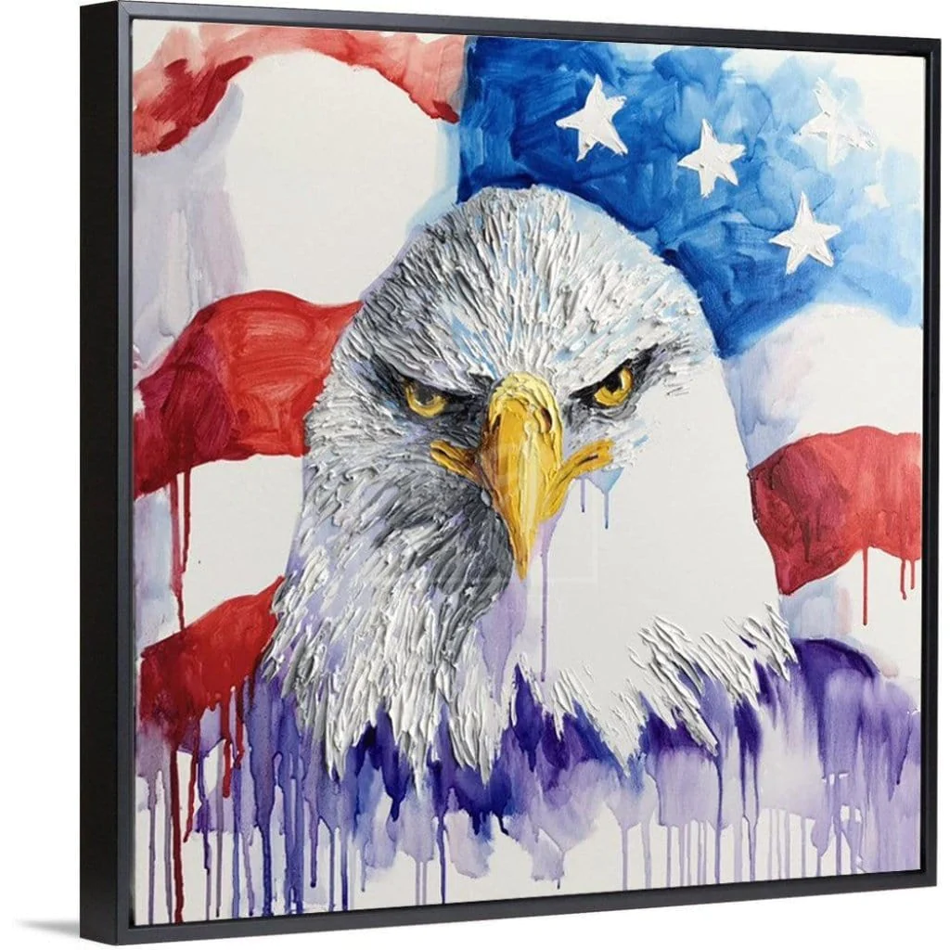

Young American Patriotic Art
2-Dimensional:*Must be on canvas or paper *Watercolor, pencil, pastel, charcoal, tempera, crayon, acrylic, pen, ink, oil, marker, or other media may be used. Theme must be patriotic in nature. If a colored American flag is used, it must be in the original colors.
3-Dimensional: Can be paper, papier-mâché, pottery, sculpture, fabric, wood, metalwork, etc. *Entries may not be larger than 18” in any direction or more than 5 lbs. in weight – jewelry, digital art and photography are not acceptable.
https://vfwauxiliary.org/wp-content/uploads/new-Young-American-Creative-Patriotic-Art-Contest-info-sheet.pdf
https://vfwauxiliary.org/wp-content/uploads/new-3-Dimensional-Patriotic-Art-entry-form.pdf

Slide 9

NEW This year!!!!
Teacher of the year was moved to Scholarships.
Open to teachers from elementary, middle and high school
Deadlines for entries:
Post: Oct 31, 2023
District: Nov 15, 2023
Department: Dec 15, 2023
All Entries must include
Wallet Photo
Completed Entry form
Resume
Nomination
2-3 other supporting documents

Slide 10

Continuing Education Scholarship is open to members, their spouses, or children over the age of 18 providing financial assistance to further their education.
Includes an essay of no more than 300 words send to National Headquarters.
Four $1,000.00 are awarded each year, in each of the four VFW Auxiliary Conferences.
Associated member must have an auxiliary membership for 1 year.
https://vfwauxiliary.org/wp-content/uploads/FILLABLE_Continuing-Education-Scholarship-Application.pdf

Slide 11
Reporting
Promoted/participated in programs (Continuing Education, Patriotic Art 2 and 3-Dimensional, Patriot’s Pen, and Voice of Democracy-Report each program and how you promoted it.)
Donated to the National Continuing Education Scholarship Contest, Young American Creative Patriotic Art Scholarship fund, 3-Dimensional Patriotic Art Contest Scholarship fund
Submitted an entry in the 2-Dimensional Young American Creative Patriotic Art Contest – (Report number of entries to the Auxiliary for judging.)
Submitted an entry in 3-Dimensional Young American Creative Patriotic Art Contest. (Report number of entries to the Auxiliary for judging.)
Hosted or co/hosted an awards ceremony to recognize awardees and participants in the Scholarships contests.
Sent in required National form for the Patriotic 3-Dimensional Art Contest
Donated to the National 3-Dimensional Patriotic Art Escrow Fund (Report how much was donated.
Other: You may report Teacher of the Year promotion and participation
Reported every quarter

Slide 12
Important Dates
VOD, and PP entry dates:
October 31, 2023 entries to local post/auxiliary chairman
November 15, 2023 entries to district post/auxiliary chairman
December 15, 2023 entries to department VFW chairman
Patriotic Art 2D and 3D entry dates:
March 31, 2024 to Auxiliary
April 15, 2024 to Department
Department will advance 1st place winner to National May 5, 2024
Teacher of the Year
October 31, 2023 entries to local post/auxiliary chairman
November 15, 2023 entries to district post/auxiliary chairman
December 15, 2023 entries to department VFW chairman
Continuing Education Due Dates:
Application must be received at National Headquarters by February 15, 2024.

Slide 13
Contact Information
Phone: 989-621-0327
Email: scholarmi23.24@gmail.com

Slide 14


